Slide 1
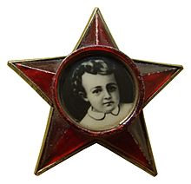
Little Octobrist

Slide 2
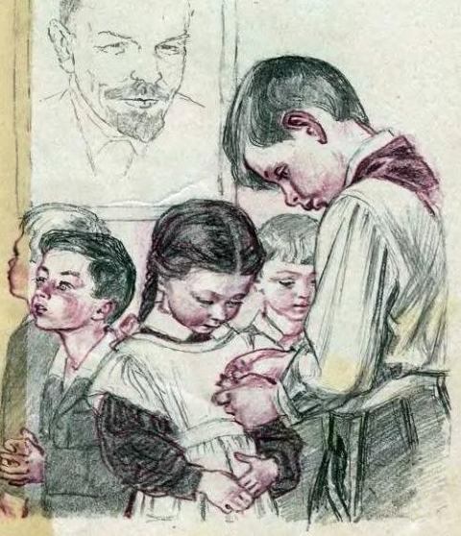
Little Octobrists (organized by Lenin)- is a Soviet term that first appeared in 1923-1924, and at that time referred to children born in 1917, the year of the October revolution. Later, the term was used as the name of a youth organization for children 7 - 9 years old. After the age of nine, in the 3rd grade, Little Octobrists would typically join the Young Pioneer organization.

Slide 3
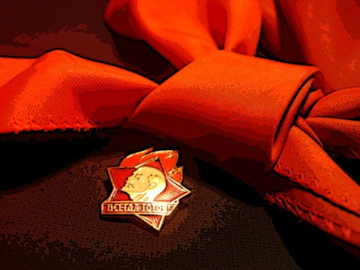
Little Octobrists were organized in groups each representing one school grade level. The group was divided into subgroups called little stars of 5 children each. Each group of Little Octobrists was under the leadership of one Young Pioneer from the Young Pioneer detachment. Every Little Octobrist wore a ruby-coloured five-pointed star badge with the portrait of Vladimir Lenin in his childhood. The symbol of the group was the little red flag.

